Slide 1
Students’ sleep and academic performance
Ângela M. Katsuyama
Post-doc, Horacio de la Iglesia’s lab
Data Science Incubator, Fall 2014

Slide 2


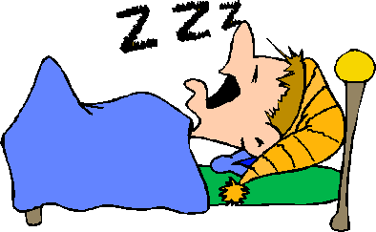
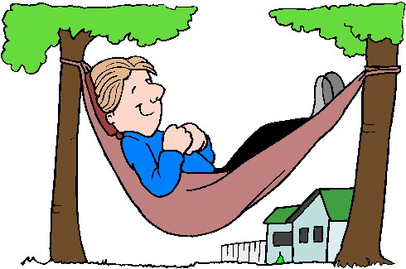
Hypothesis: Poor academic performance in college students correlates with poor sleep behaviors
Post-Tone
Course: Biological Clocks and Rhythms, Spring 2014
72 students, seniors
Data recorded over: 6 days, including 1 weekend.
Purposes: Research, teaching and public health goals.
Sleep parameters:
chronotype
social jetlag
variability of sleep onset, duration, offset etc
Performance: grades (midterms, quizzes etc)

Slide 3
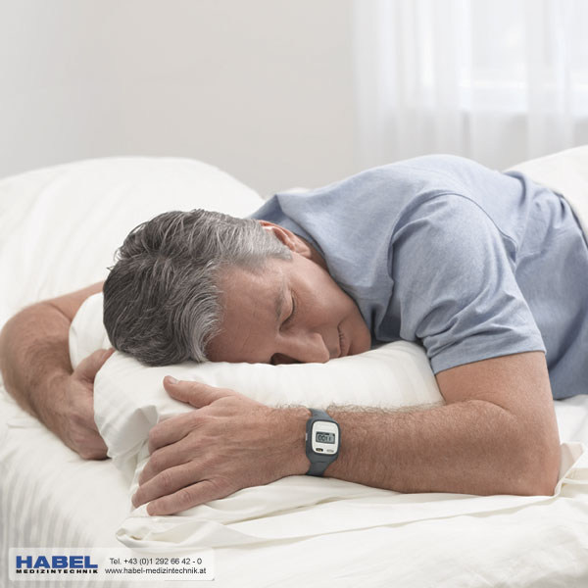

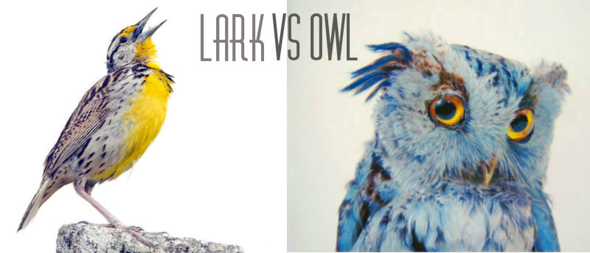


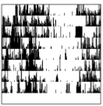
Datasets and Scientific Questions
Data from:
1)
Example:
Actiwatch
2)
Sleep Diary
3)
Chronotype
questionnaires
Correlated to:
Grades?
Gender?

Slide 4
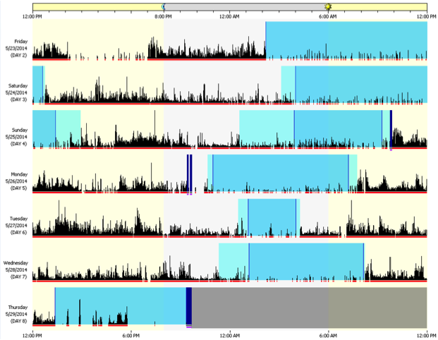
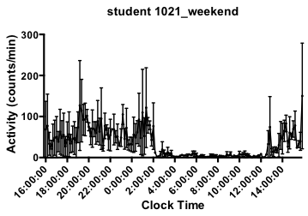
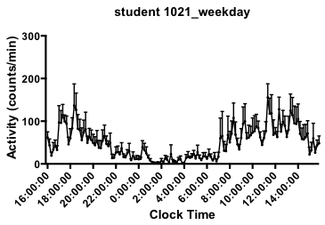
Example of individual student’s actograms
Weekend Weekday

Slide 5
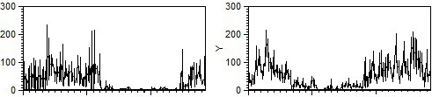
Individual student’s actograms: Incubator results match with manually-processed data
Weekend Weekday
Activity
Incubator Manual
16 20 00 4 8 12 16 16 20 00 4 8 12 16
Clock time Clock time

Slide 6
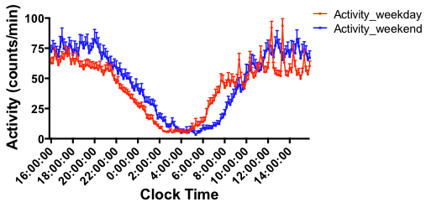
During weekend, students go to bed later,
wake up later and sleep more than during weekdays
Post-Tone

Slide 7
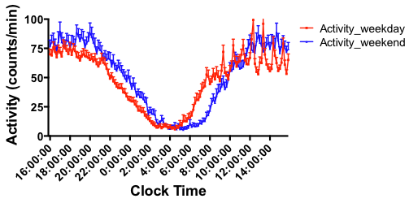
Entire class average waveforms: Incubator results match with manually-processed data
Post-Tone
Incubator Manual

Slide 8
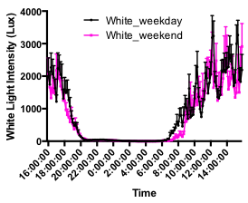
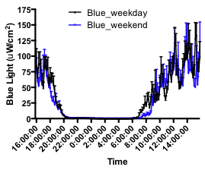
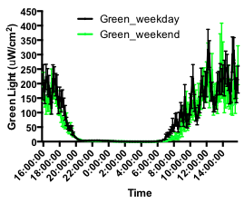
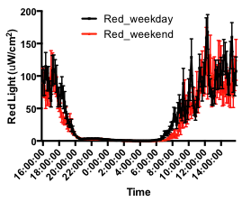
On weekend, students’ exposure to light
in the morning is delayed
Post-Tone

Slide 9
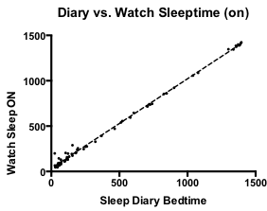
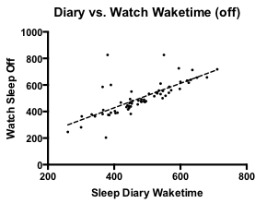
Although self-reported, diary information correlates for the most part with actiwatch data
(Min after midnight)
(Min after midnight)
P < 0.0001

Slide 10
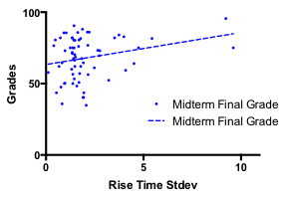
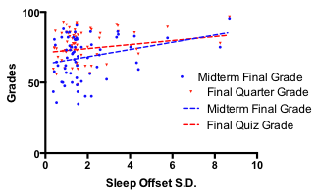
Wake time SD and Rise time SD (from Sleep Diary) correlate with grades: higher variations correlated high higher grades
Post-Tone
Wake time SD vs. Grades
Rise Time SD vs. Grades
Midterm Final Grade: P = 0.0249
Final Quarter Grade: P = 0.0490
P = 0.0396

Slide 11
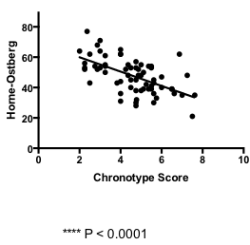
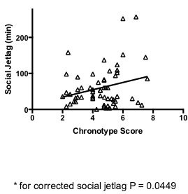
Collected data agrees with results from literature:
Late types tend to have bigger social jetlags
Chronotype questionnaires scores correlate with each other
Post-Tone
Chronotype score vs. Social Jetlag
Chronotype vs. Horne-Ostberg scores
P = 0.0449
P < 0.0001

Slide 12
Summary
Conclusions:
Most sleep parameters did not correlated with performance. Bigger N needed for definite conclusions.
Some correlations agree with literature data: later chronotypes have bigger social jetlags and females tend to be earlier types.
Students go to bed later, wake-up later and sleep more on weekends.
On Weekend, student’s exposure to light is delayed in the morning.
Post-Tone
Future directions:
Obtain bigger N.
Add demographic data (ethnic, socio-cultural, living on/off campus data etc) to correlate with sleep patterns and performance.

Slide 13



Acknowledgements
Horacio de la Iglesia (PI)
de la Iglesia lab
Gideon Dunster (help with manual analysis)
eScience team:
- specially Bill Howe and Dan Halperin
NSF for funding

